Slide 1
Severstal steel defect segmentation
Andrea Bionda

Slide 2
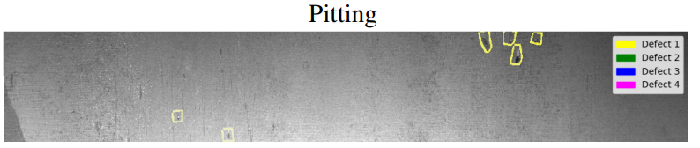
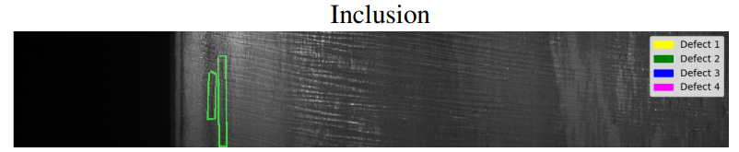
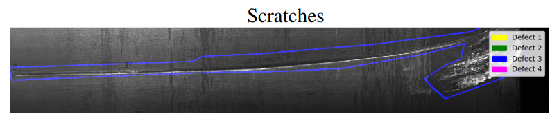
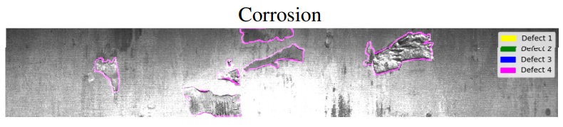
Problem formulation
The problem consists in segmenting and classifying defects over steel sheets that come from high frequency cameras.

Slide 3
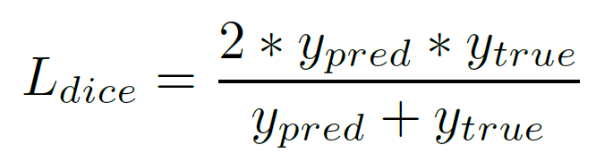
Purposes
Metrics
The proposed solution is built focusing on two expected results: a precise defect segmentation and labelling, and an accurate classification between defective and non-defective images, in order to reduce false positives, and so waste of money and resources.
The evaluation metrics is the so called Dice coefficient, which is not only an accuracy index, but it also penalizes the false positives found by the method, more similar to precision.

Slide 4
Related works
Residual Networks: The main idea is to add an identity shortcut connection between blocks (group of convolutional layers), in such a way that each one learns features from both previous block and input value.
EfficientNet: The idea behind this family of Convolutional Neural Network is to scale a baseline model in width, depth, and resolution by a constant ratio, in order to obtain higher accuracy at lower parameters’ number.
U-Net: This architecture is composed of two concatenated parts: the contracting path works as a classical FCNN to extract meaningful feature from the image, while the expansive path builds a high resolution output starting from the feature extracted during the first phase. In order to achieve higher semantic levels each up-sampling layer is enriched with features information extracted in the corresponding downsampling layer

Slide 5
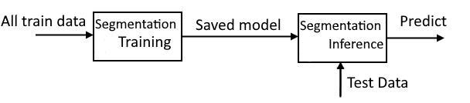
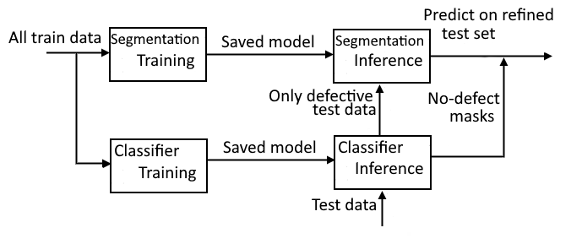
Proposed solutions
First approach: Classical semantic segmentation pipeline
Second approach: semantic segmentation on refined set of defective-only images

Slide 6
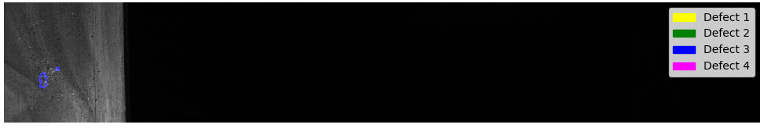
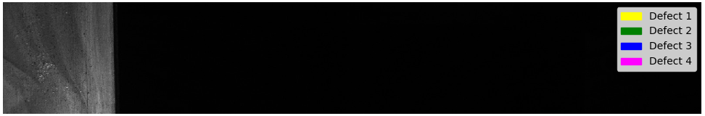
Proposed solutions
The rationale behind the second approach is that usually false defects have a very similar pattern compared to real defects, for this reason a specific binary classifier is used for trying to avoid the problem. Recognizing defects on good images strongly penalizes dice coefficient.
Segmentation only: dice 0.0037
Complete pipeline: dice 1.0

Slide 7
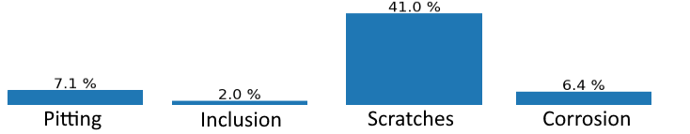
Dataset
The dataset is composed of 12568 greyscale images of size 1600x256x3 and their corresponding defective masks.
The dataset exhibits a fairly even distribution between defective (56%) and non-defective images (44%), but among the defective ones we can notice a strong imbalance between defect classes.

Slide 8
Segmentation implementation
The semantic segmentation task is performed by a U-Net based model: the encoder part follows the EfficientNet-B3 architecture, while the decoder part, instead, is a classical U-Net expansion path.
Even if Softmax should be the straightforward choice for multiclass segmentation by definition, this means that I have to treat 'no Defect' pixels as a separate class altogether. In my opinion, this decision will stress even more the imbalanced data issue The usage of Sigmoid activation function, instead, brings the network to perform four “one vs all” independent decisions, whether that pixel belongs to the corresponding class or not.

Slide 9
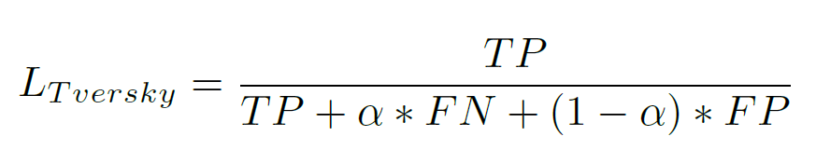
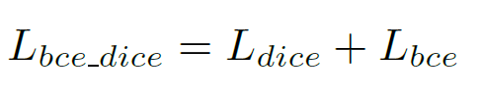
Segmentation implementation
Multiple random crop of the input images ((5,256,384) , (5,256,512))
Batch balanced in the defect classes
Data augmentation (affine and color transformations)
Balanced bce_dice loss for 70 epochs and then Tversky loss for other 40 epochs with alpha equal to 0.3
Adam optimizer with initial learning rate of 0.001, iteratively halved on plateaus

Slide 10
Classification implementation
The structure of the classifier follows the classical ResNet50 architecture, the last part of Fully Connected layers is removed and replaced by a Global Averaging Pooling layer attached with a sigmoid activation over the single binary output.
Train on original image size
Data augmentation (affine and color transformations)
Categorical cross entropy loss
Adam optimizer with initial learning rate of 0.001, iteratively halved on plateaus

Slide 11
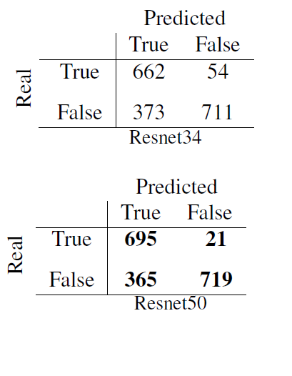
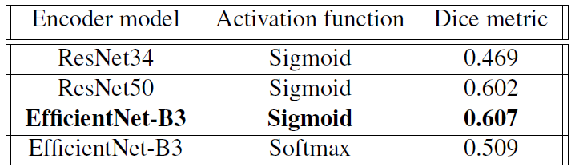
Experimental results
Classification confusion matrices
Segmentation Dice metrics

Slide 12
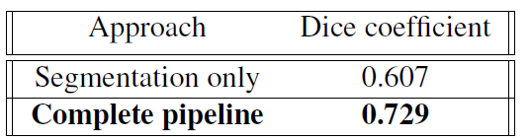
Experimental results
Approaches comparison:
Segmentation: Unet with EfficientNet-B3 encoder Classification: ResNet50

Slide 13
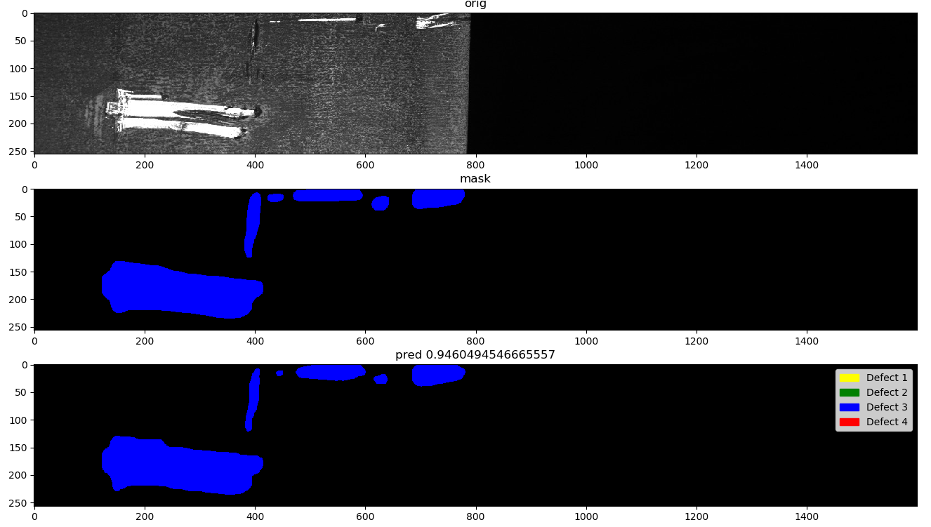
Experimental results

Slide 14
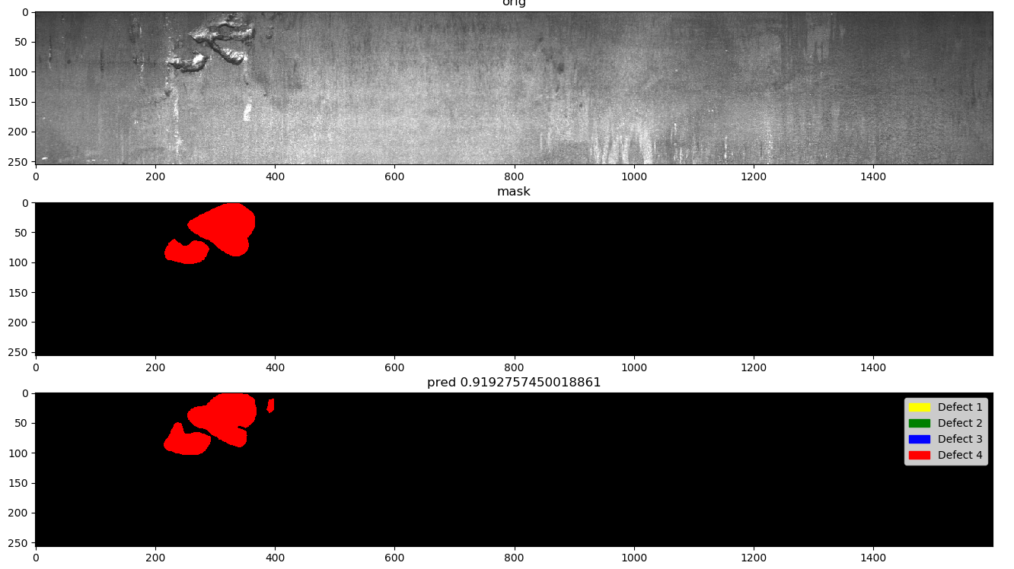
Experimental results

Slide 15
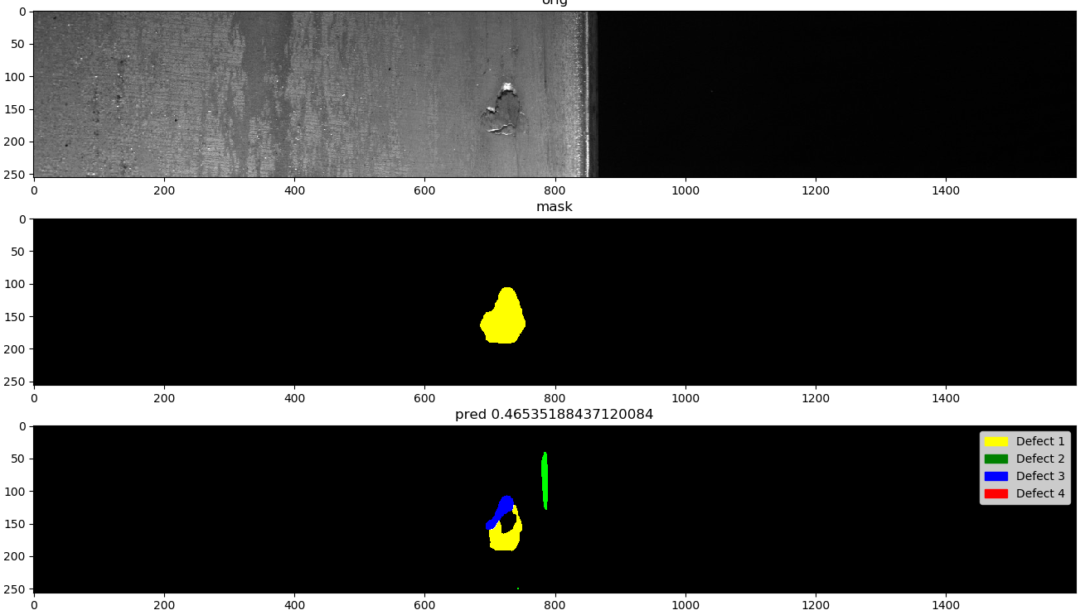
Experimental results

Slide 16
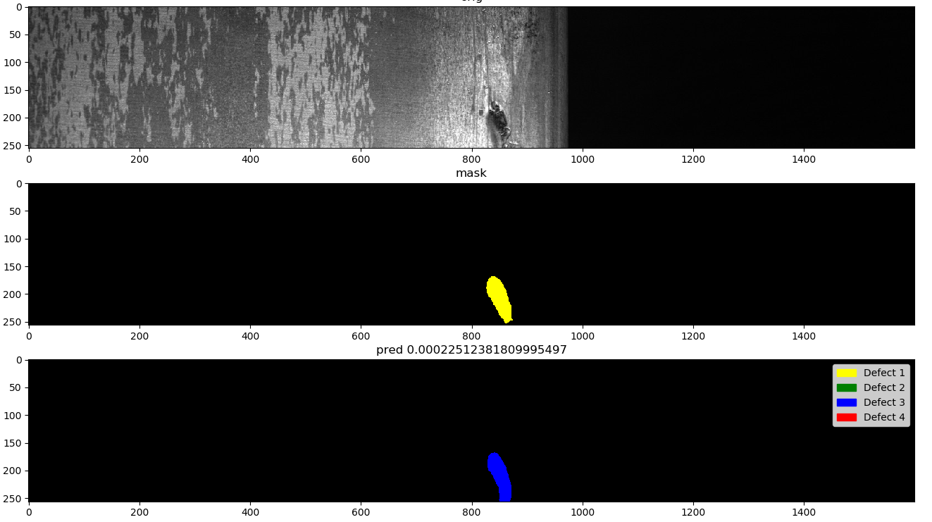
Experimental results

Slide 17
Conclusion
This project leverages the semantic segmentation and classification techniques to solve the steel defect detection problem. From the experiments arises that the combination of these two techniques works particularly well as a tradeoff between accuracy and precision.
Future improvements should be focused on semantic segmentation:
Ensemble learning
Loss function that takes in consideration defect class distribution

